Slide 1
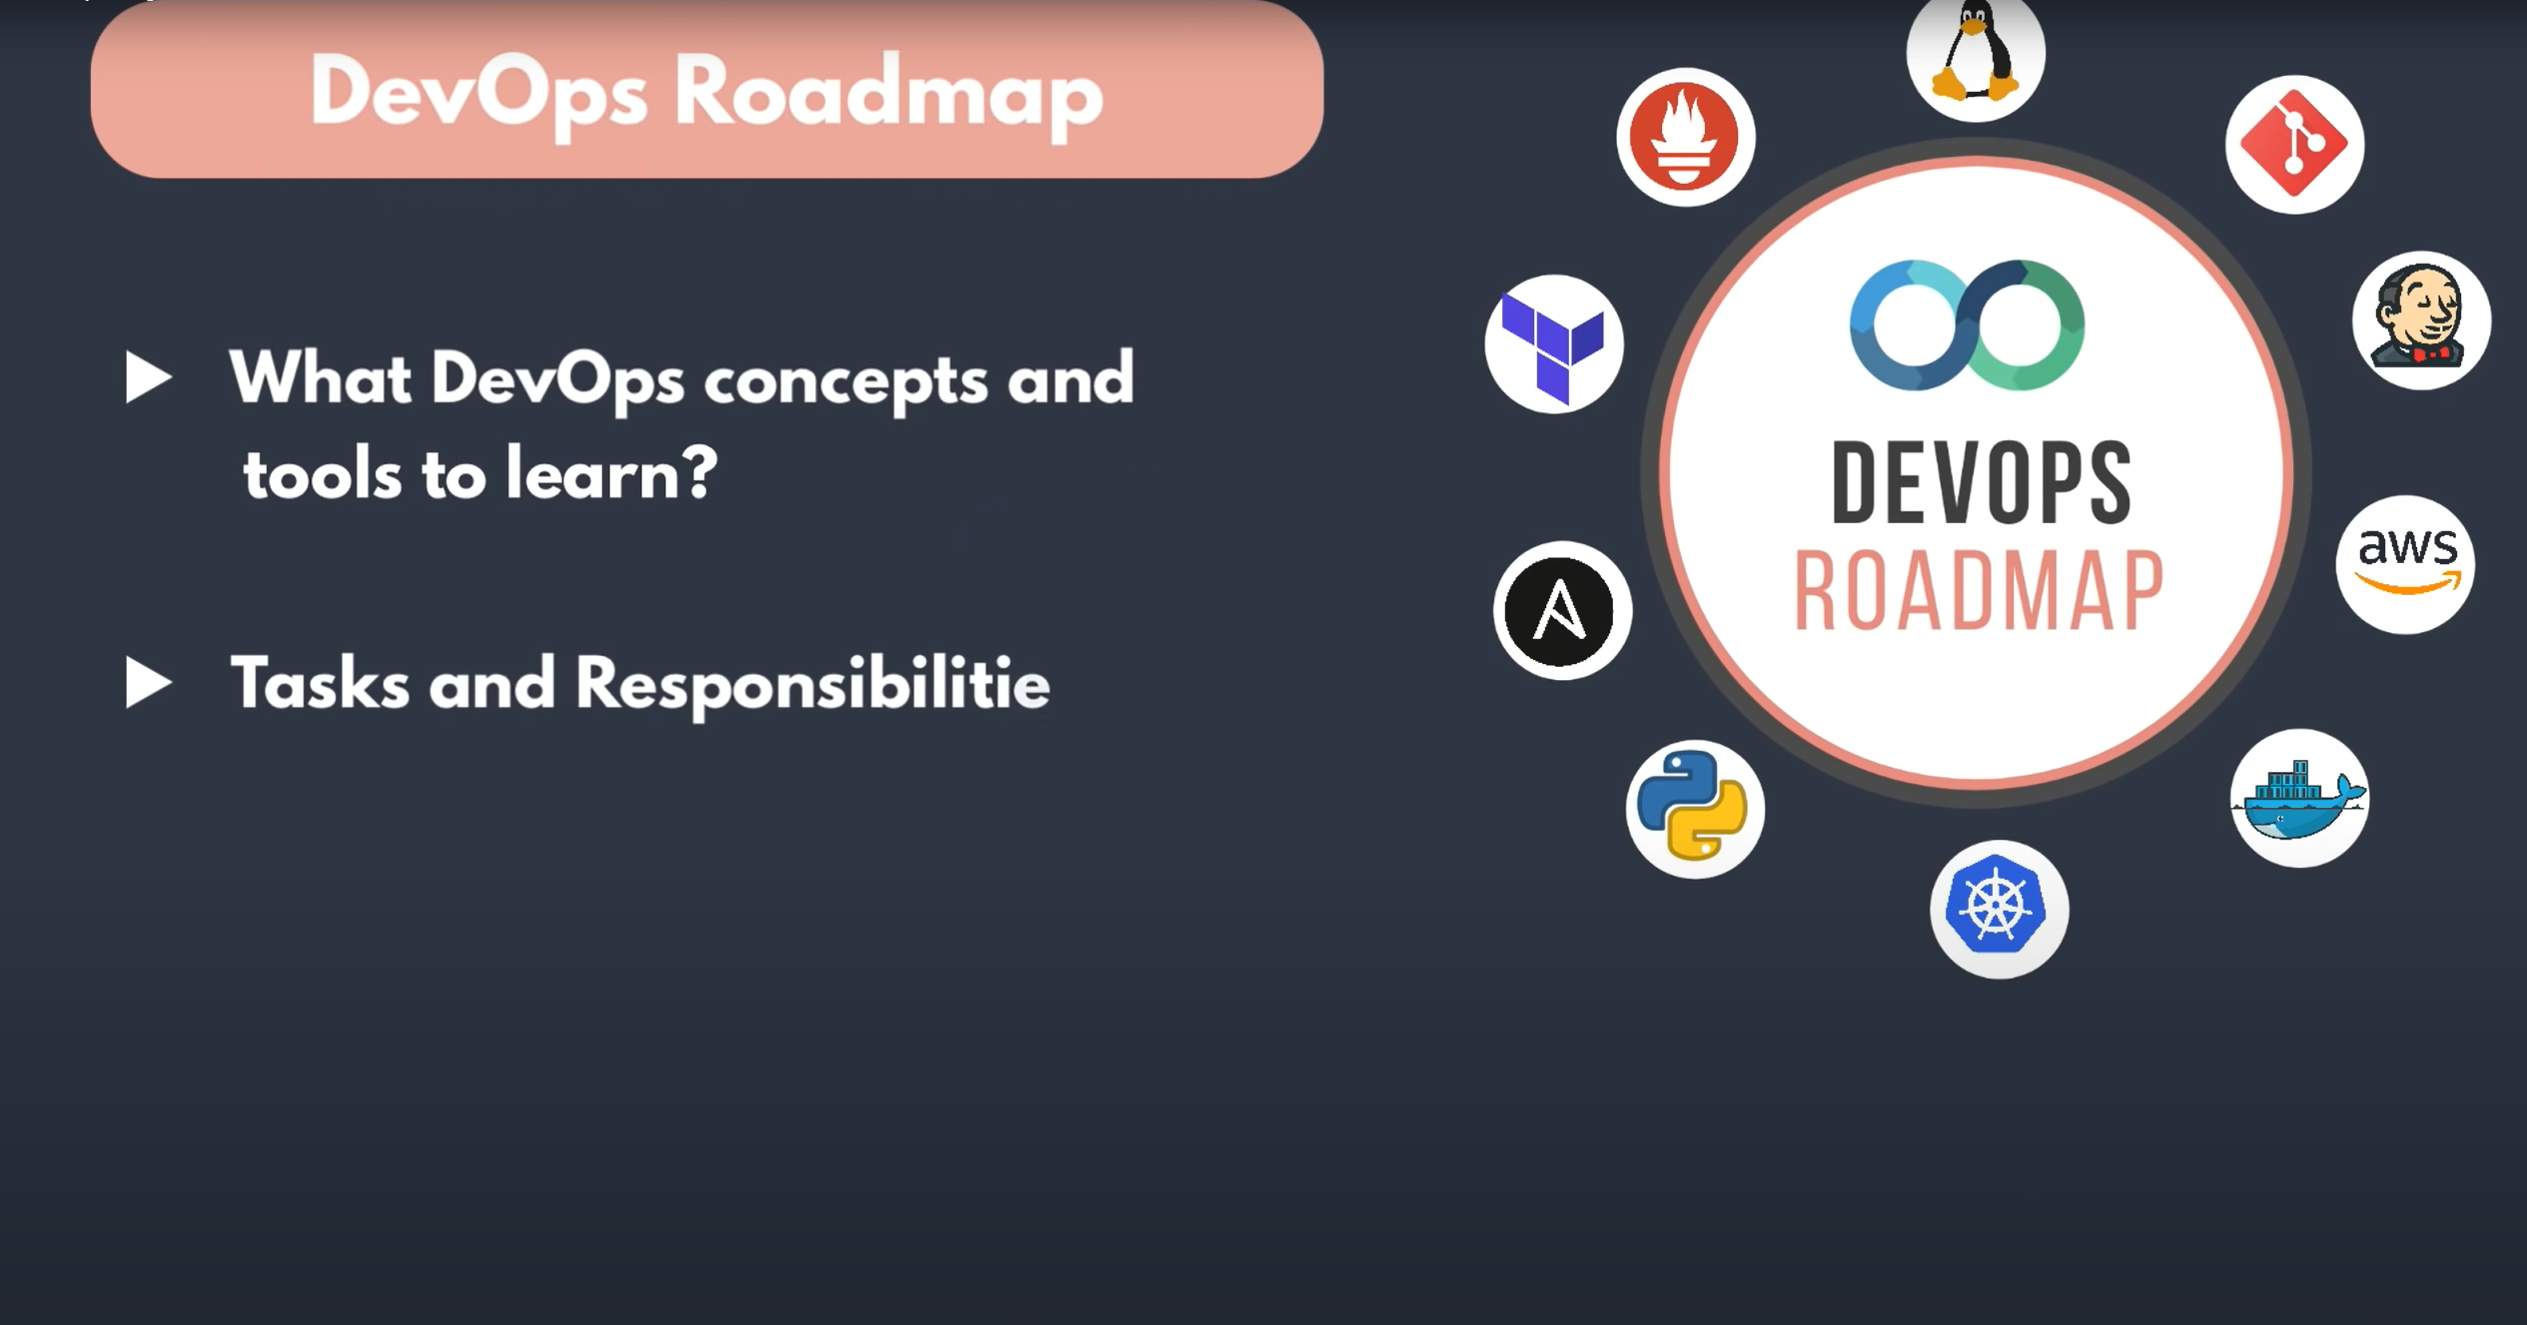

Slide 2
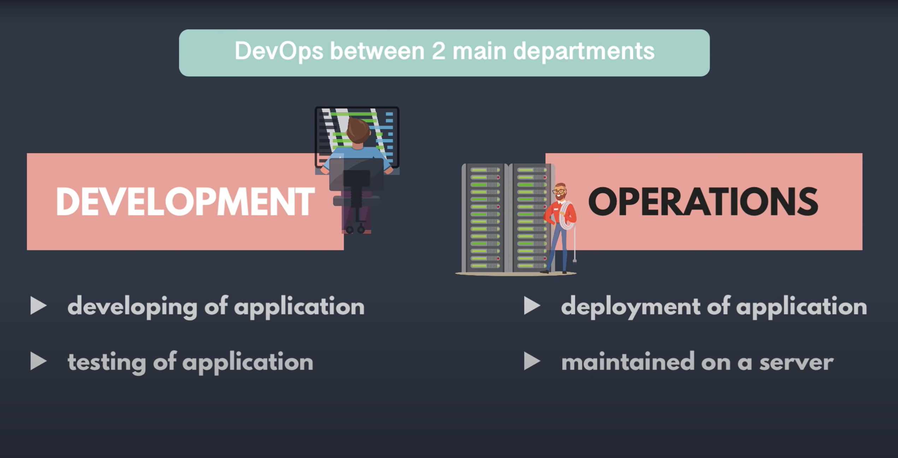

Slide 3
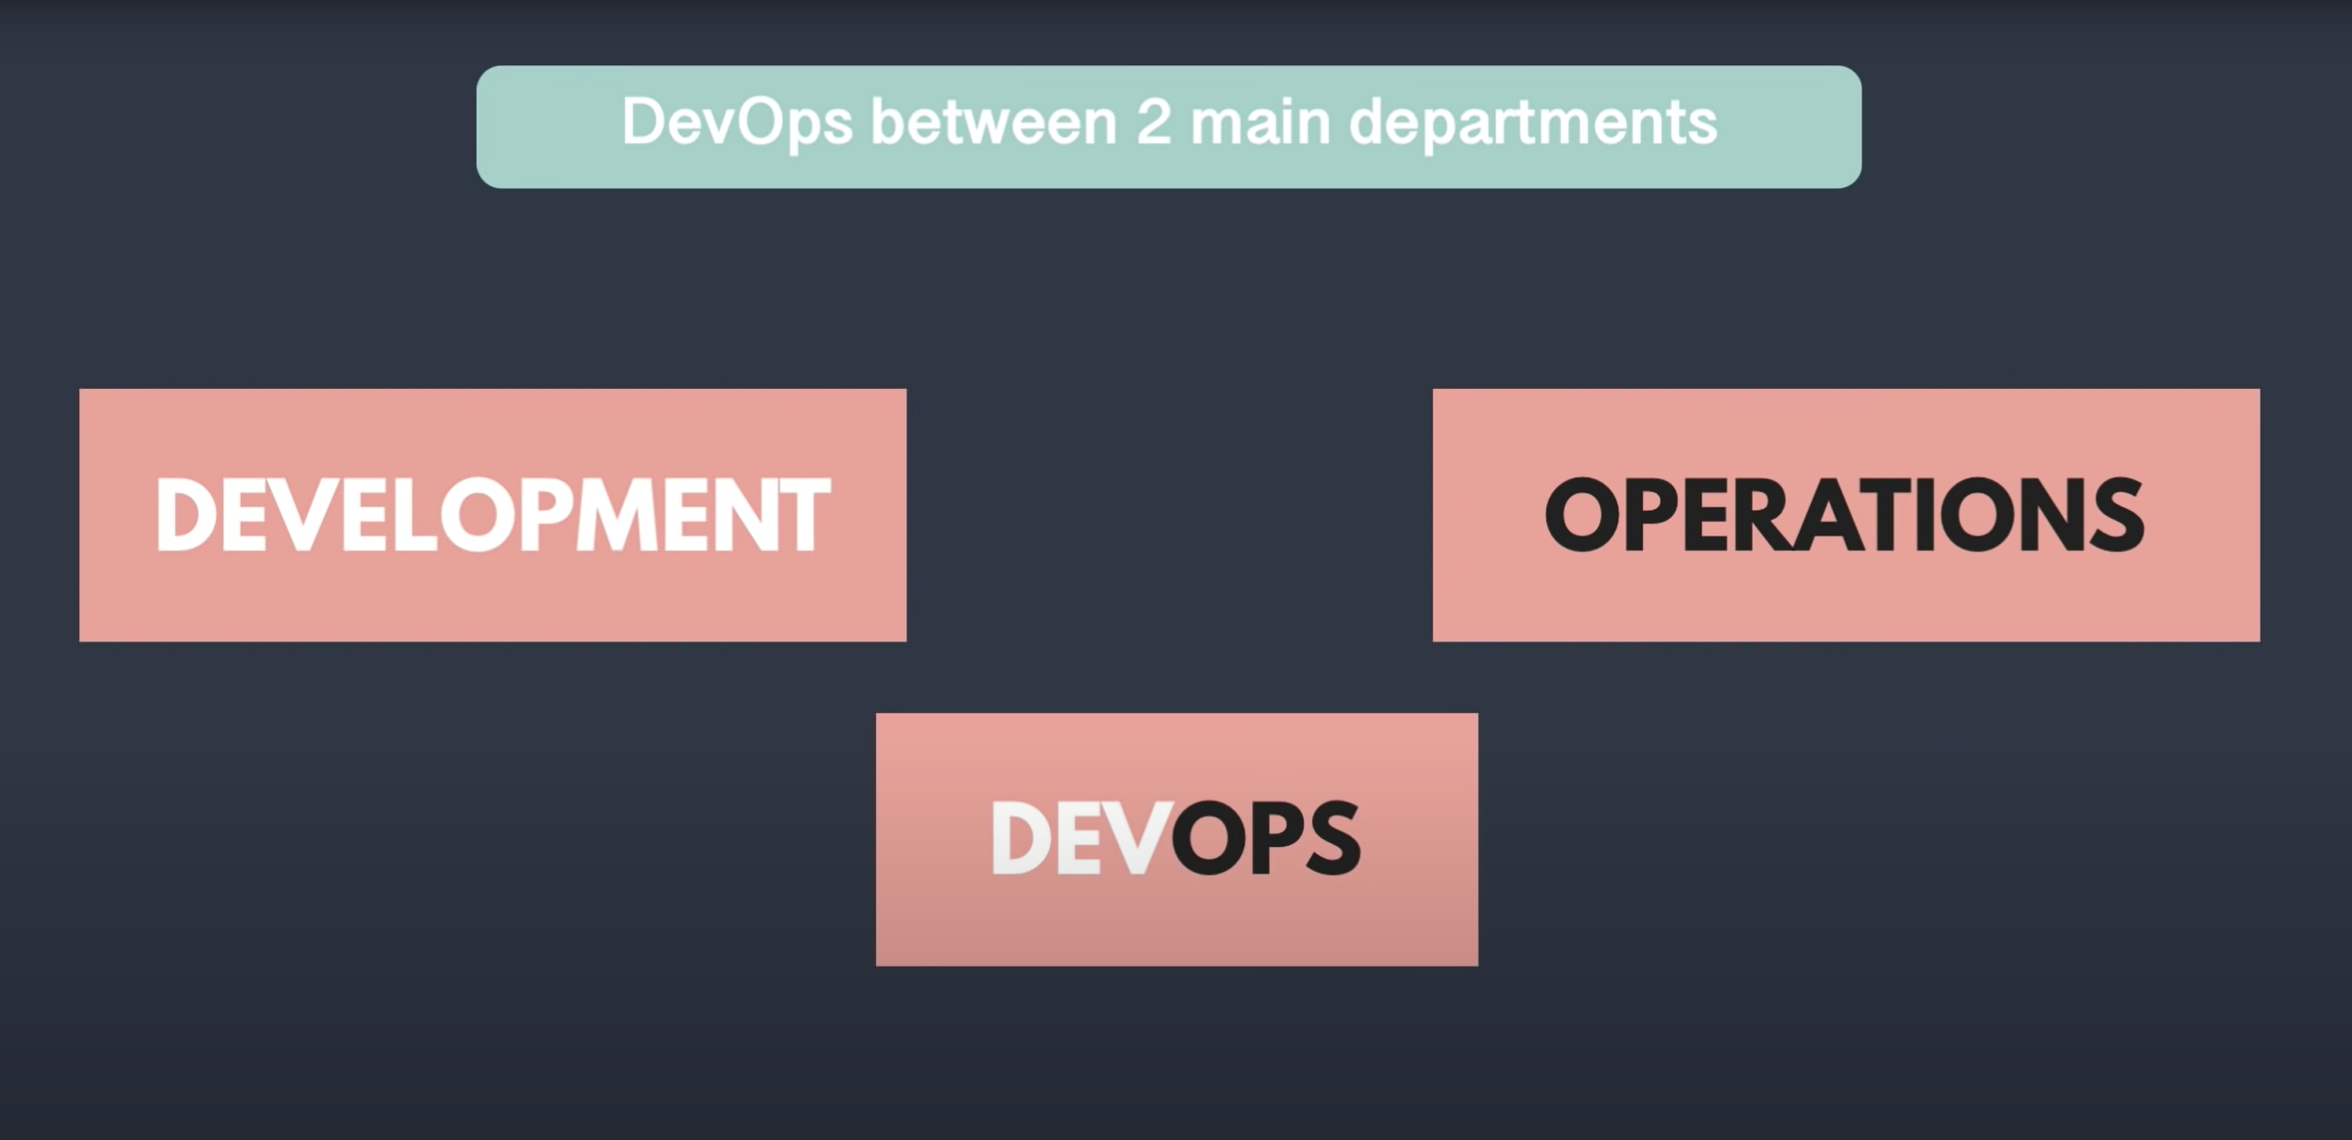

Slide 4


Slide 5
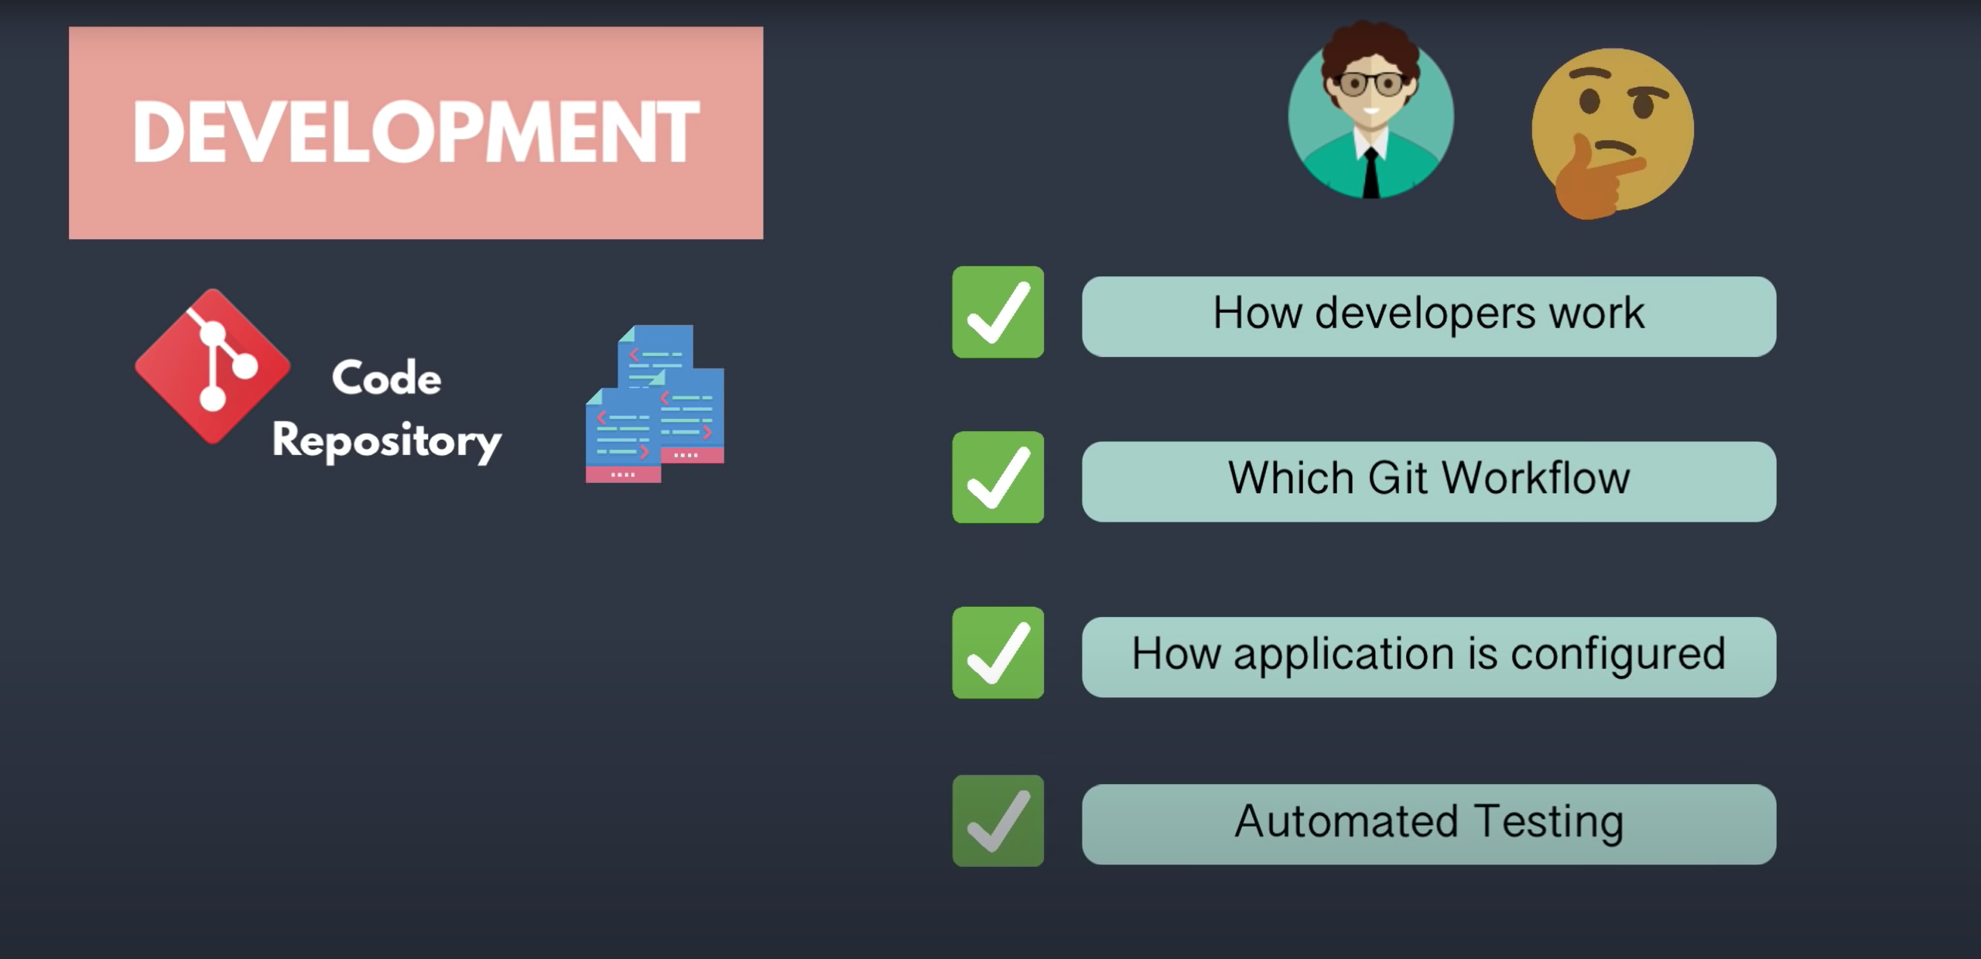

Slide 6


Slide 7
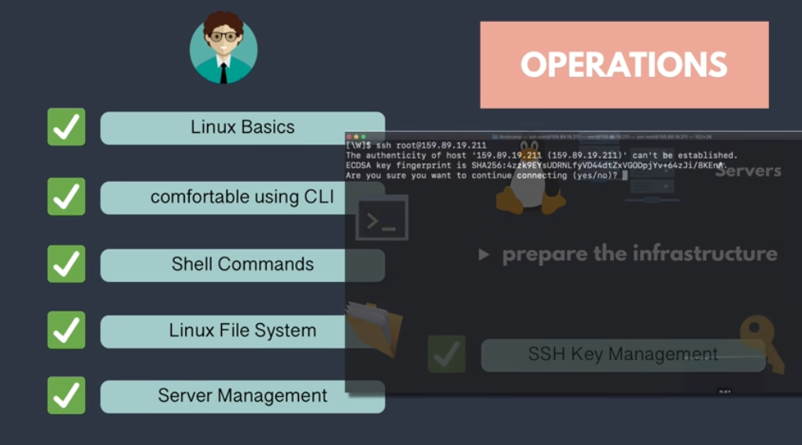
Top free vmstat iostat isof fdisk fstab

Slide 8


Slide 9
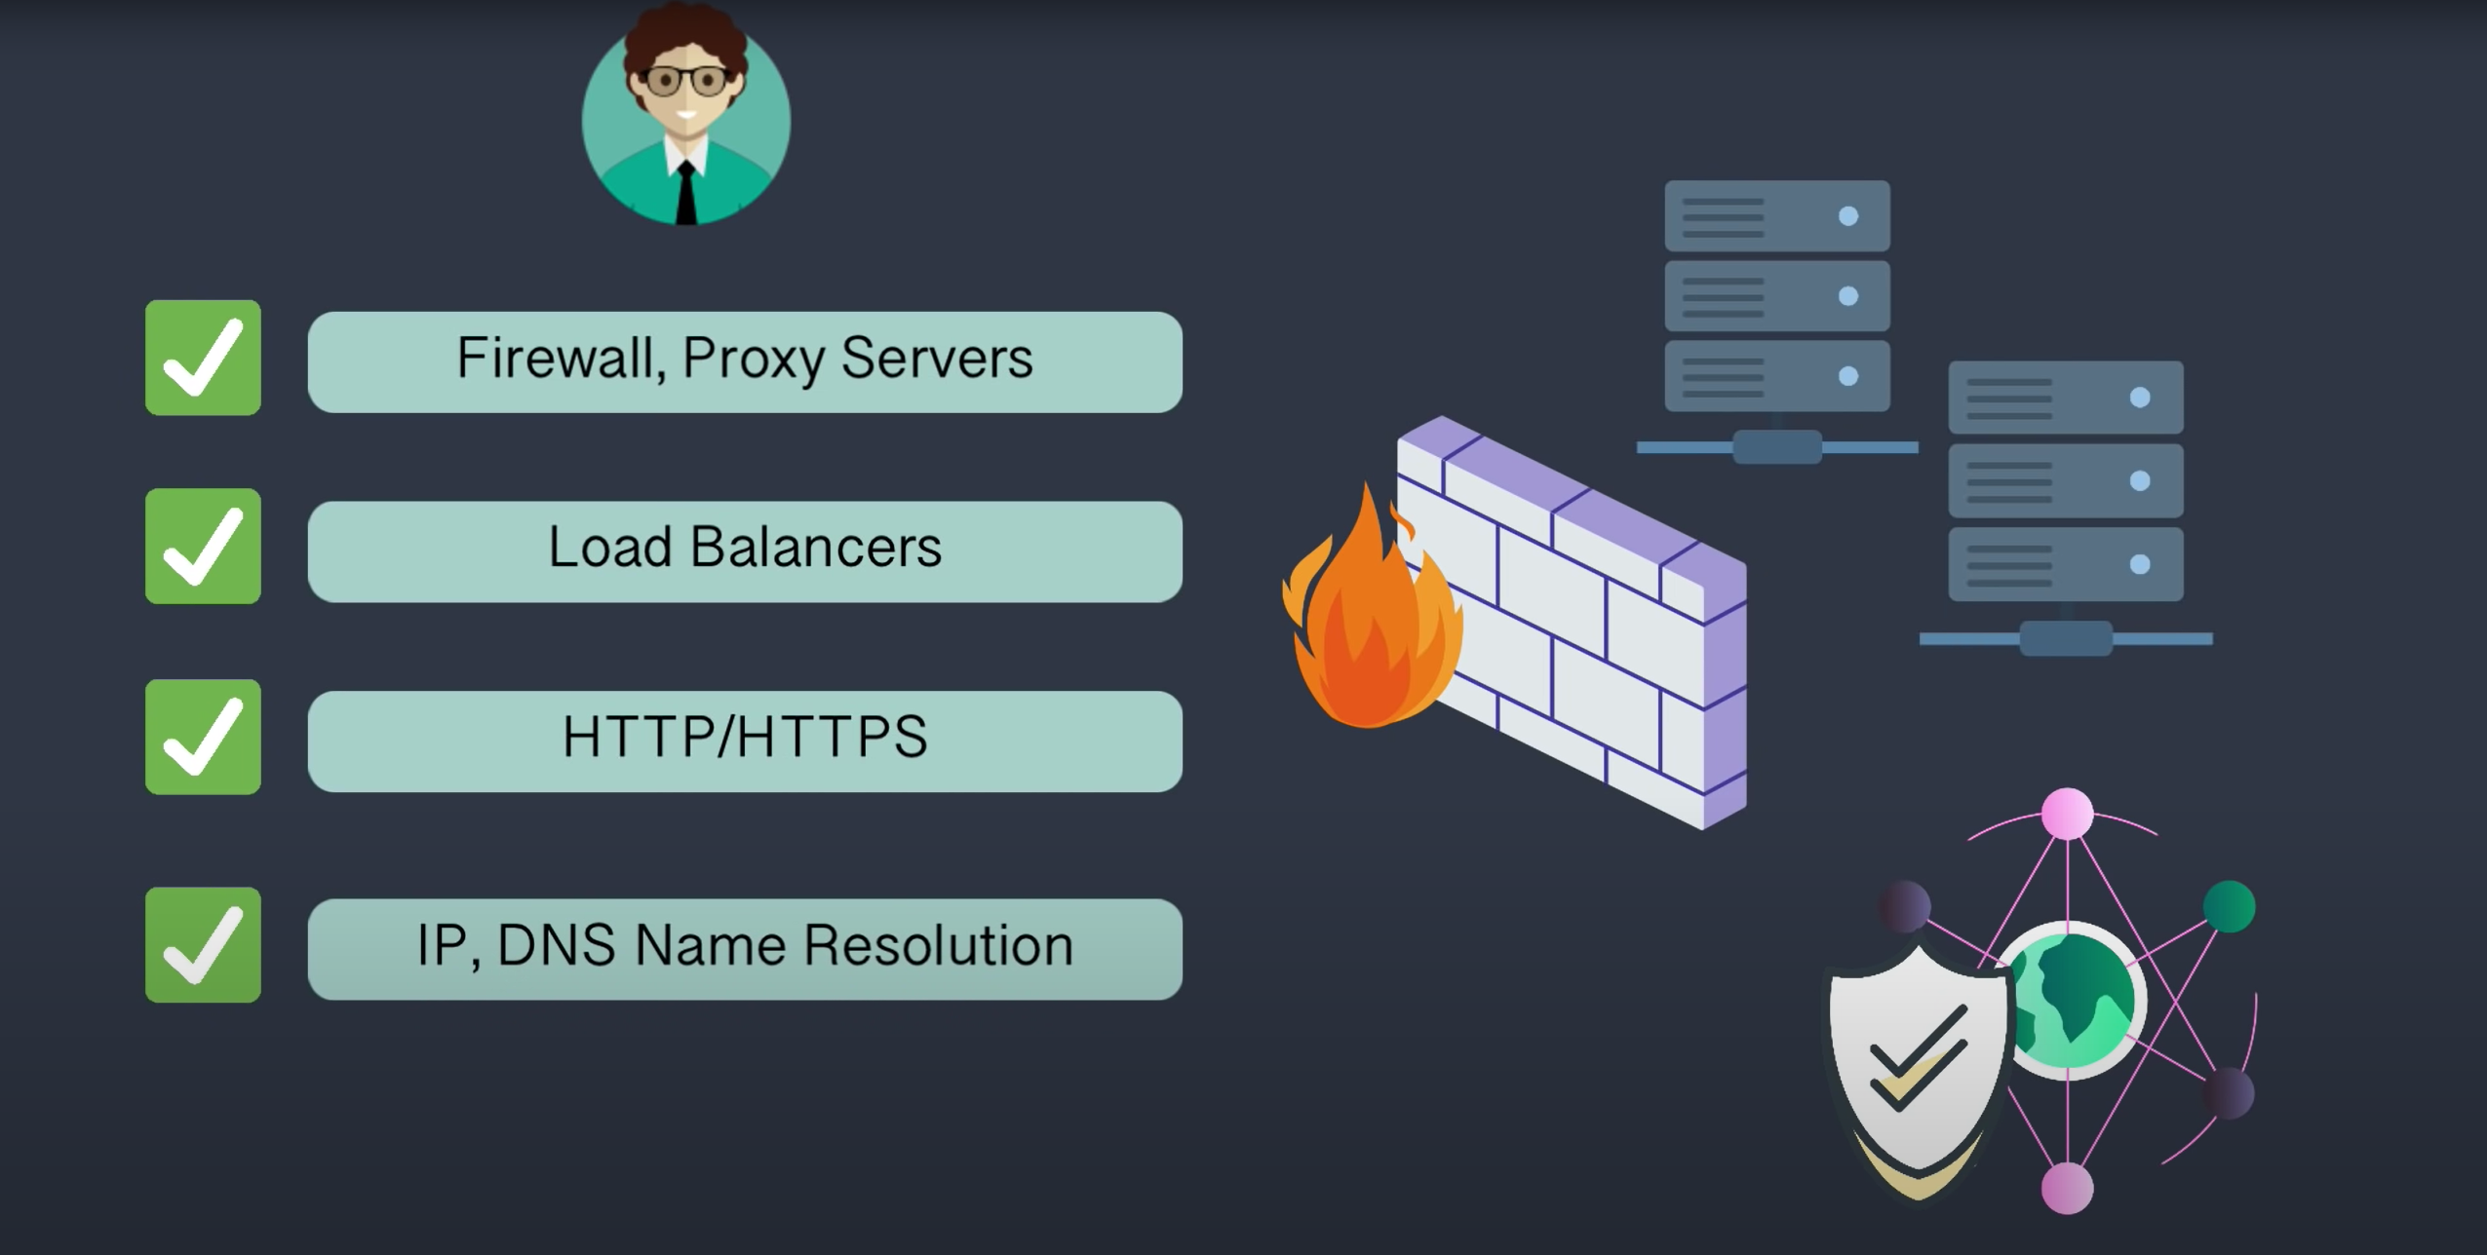
Web Server: Apache, IIS or NGNIX Others: Load Balancers, Layer 4 vs Layer 7, HA Proxy and open ports

Slide 10
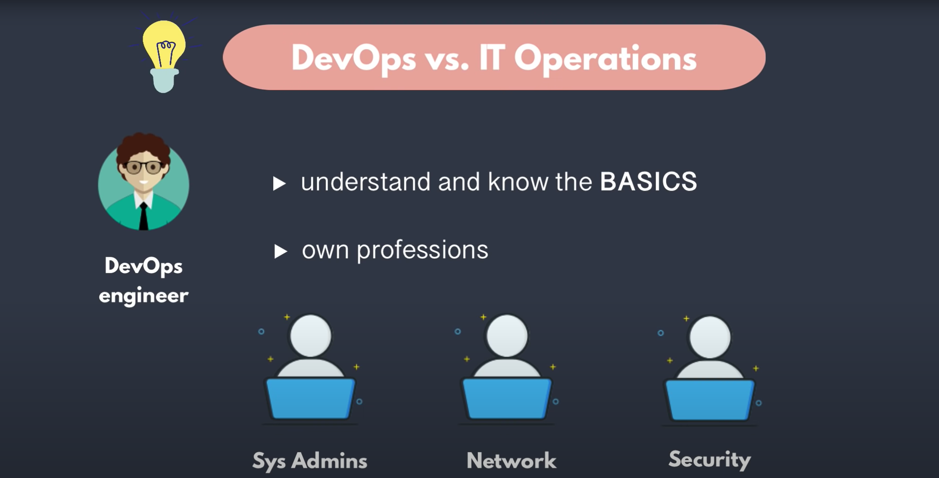

Slide 11


Slide 12
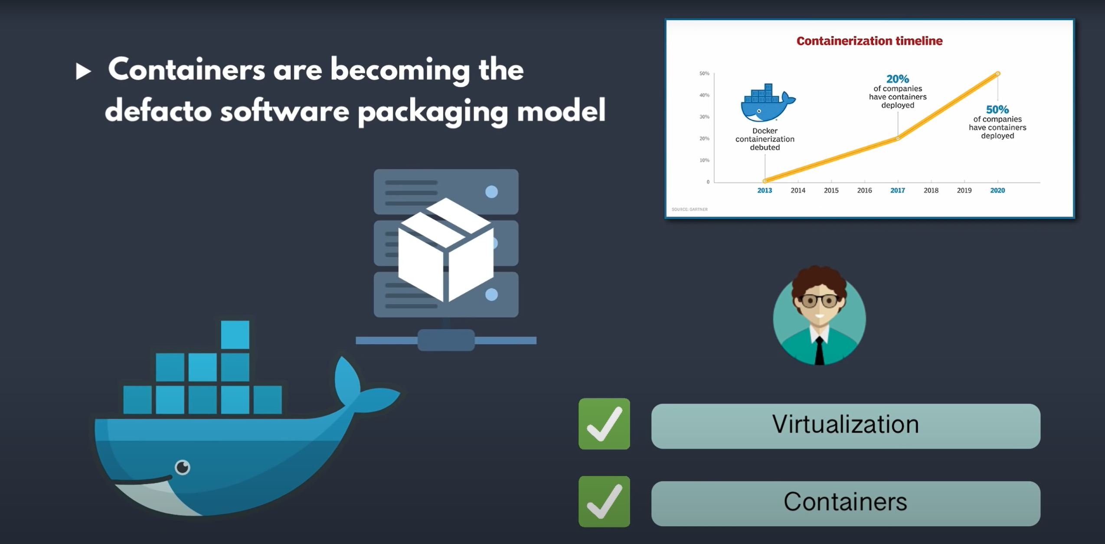
Virtualization: Bare-Metal (E.g. Xen, KVM etc.), Hosted (E.g. Virtual Box, VMware workstation etc.)
Dockers: GKE, EKS, sample website using Dockers.

Slide 13
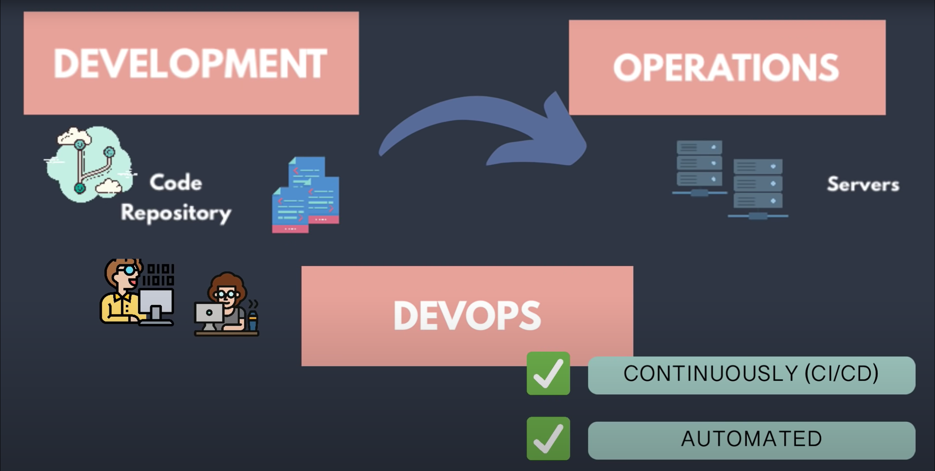

Slide 14
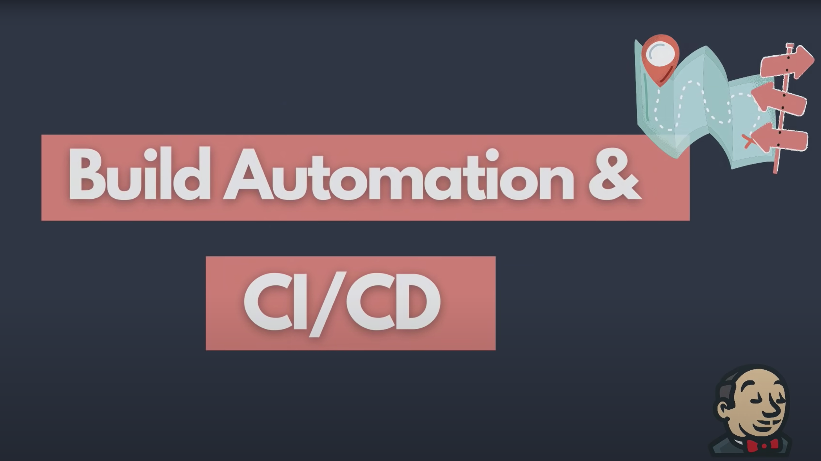

Slide 15
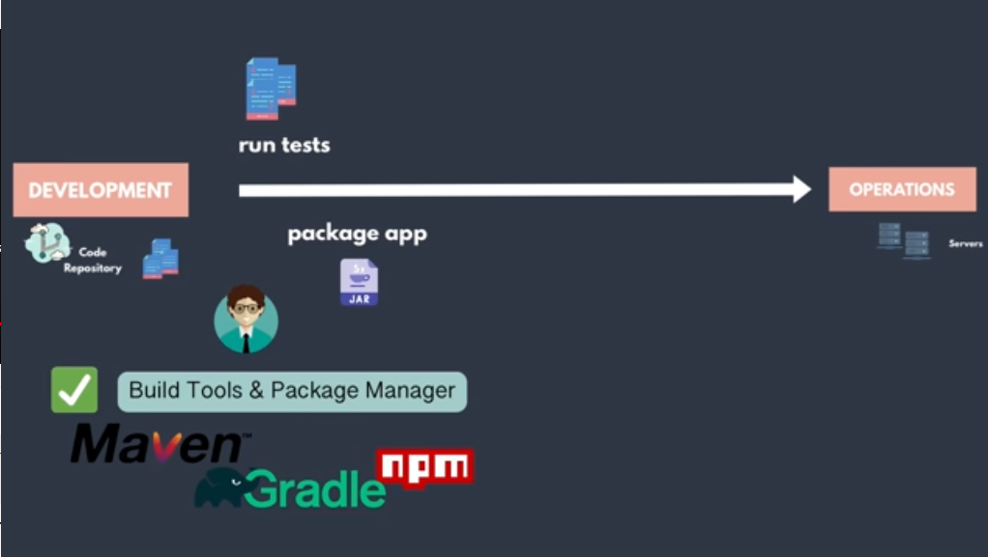

Slide 16
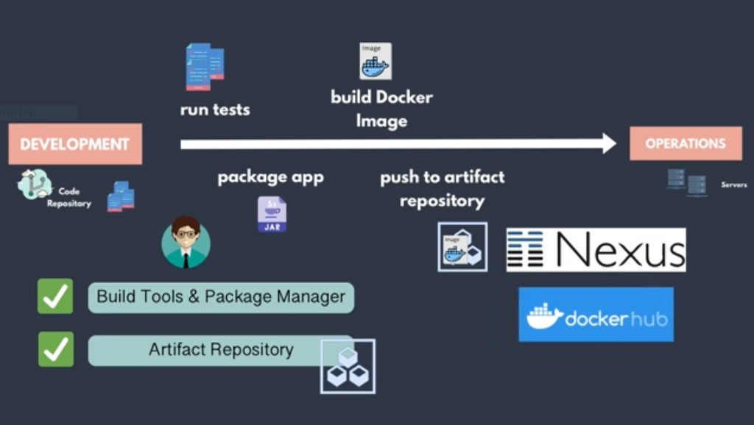

Slide 17
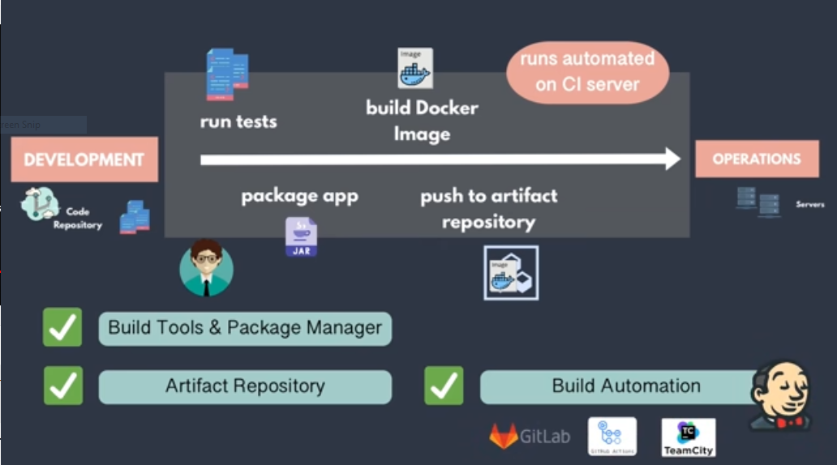

Slide 18
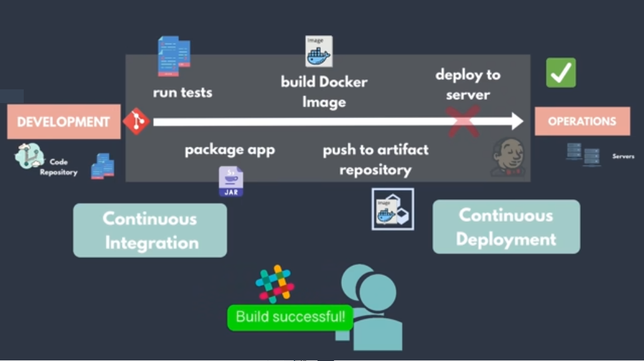

Slide 19
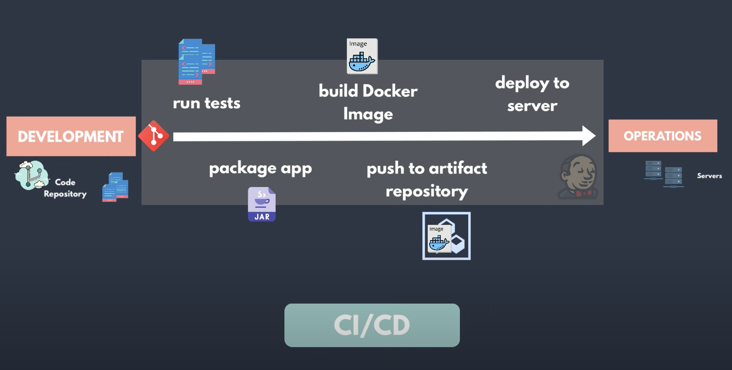

Slide 20
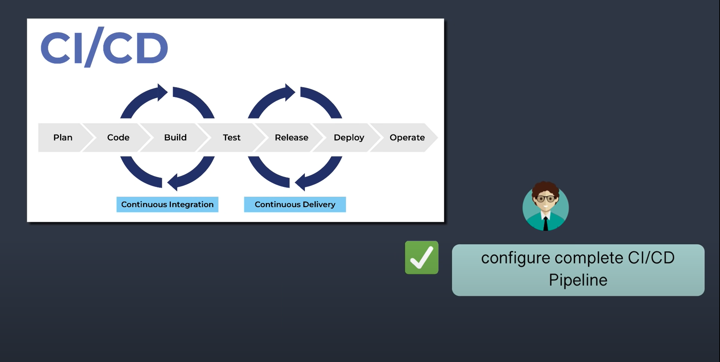

Slide 21
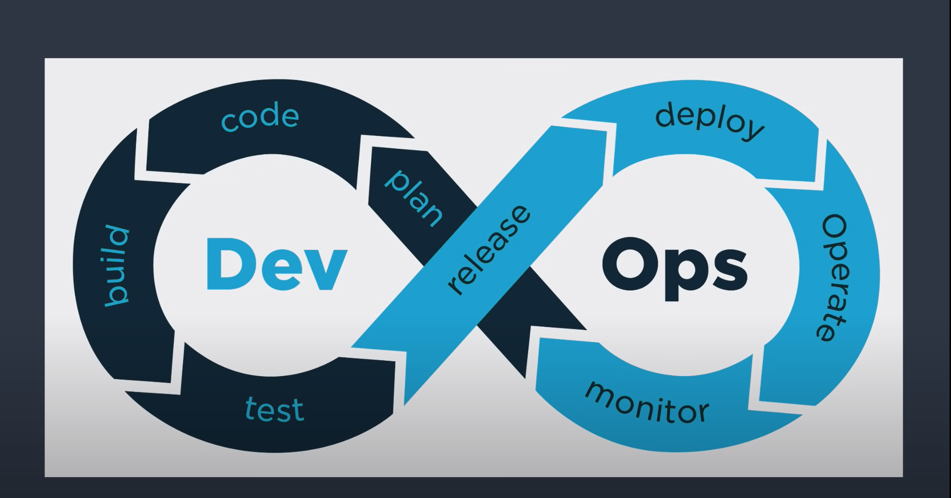

Slide 22


Slide 23
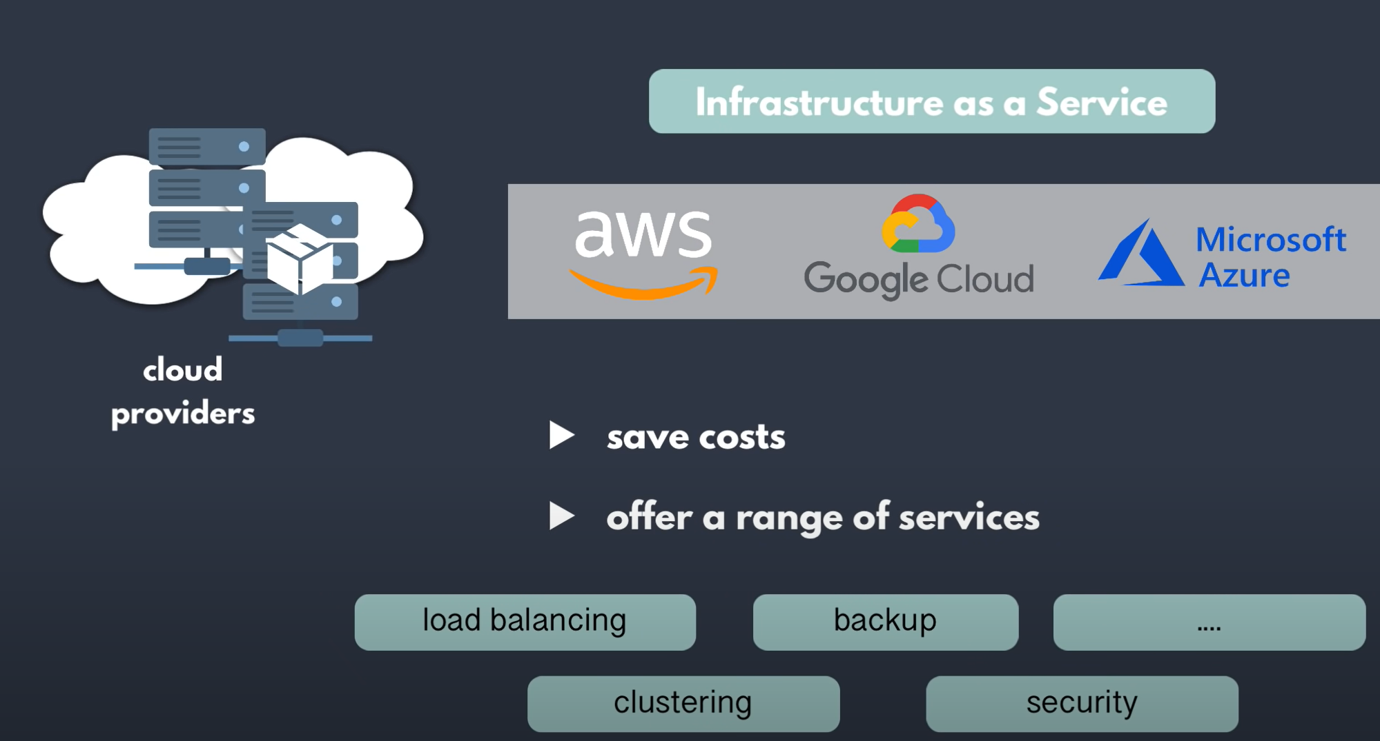

Slide 24
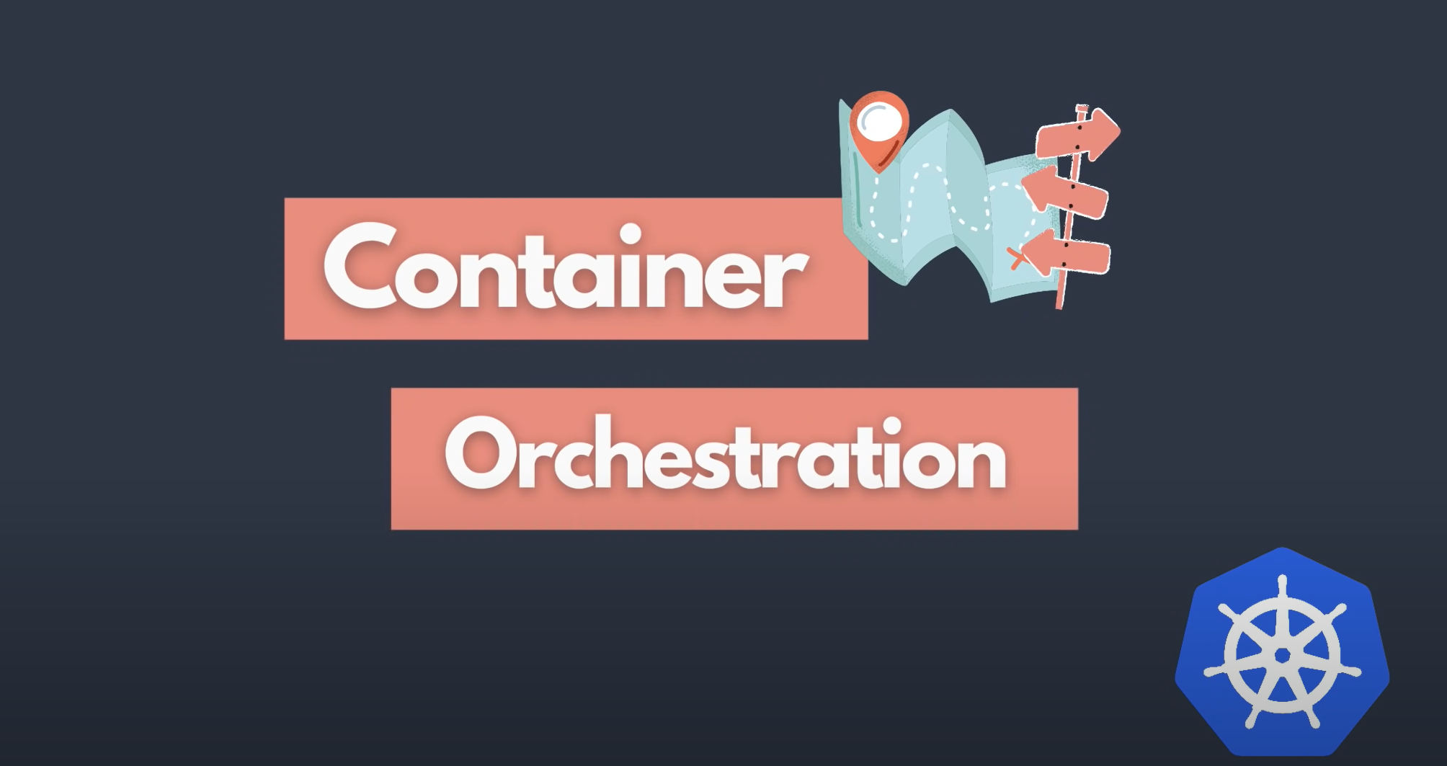

Slide 25
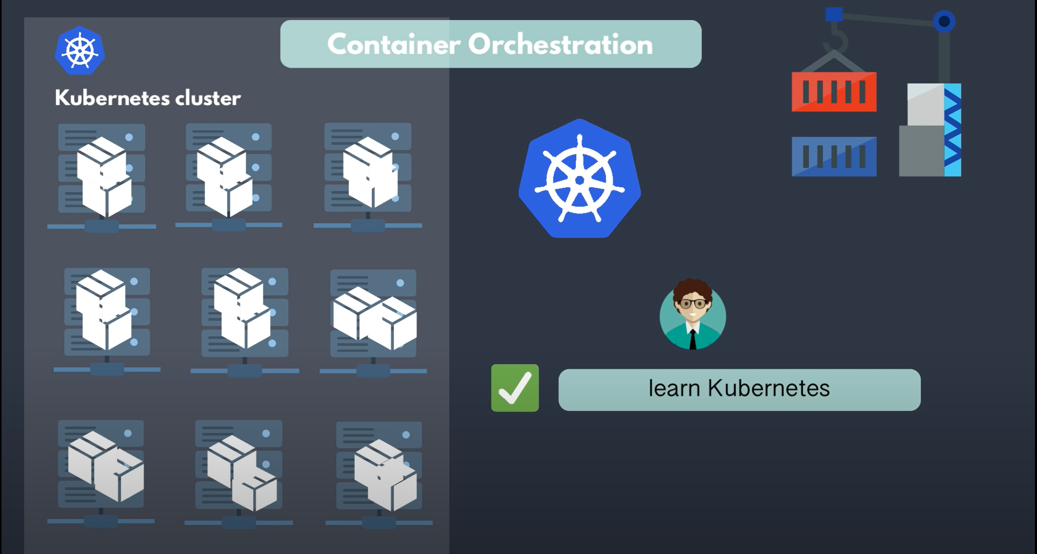

Slide 26


Slide 27
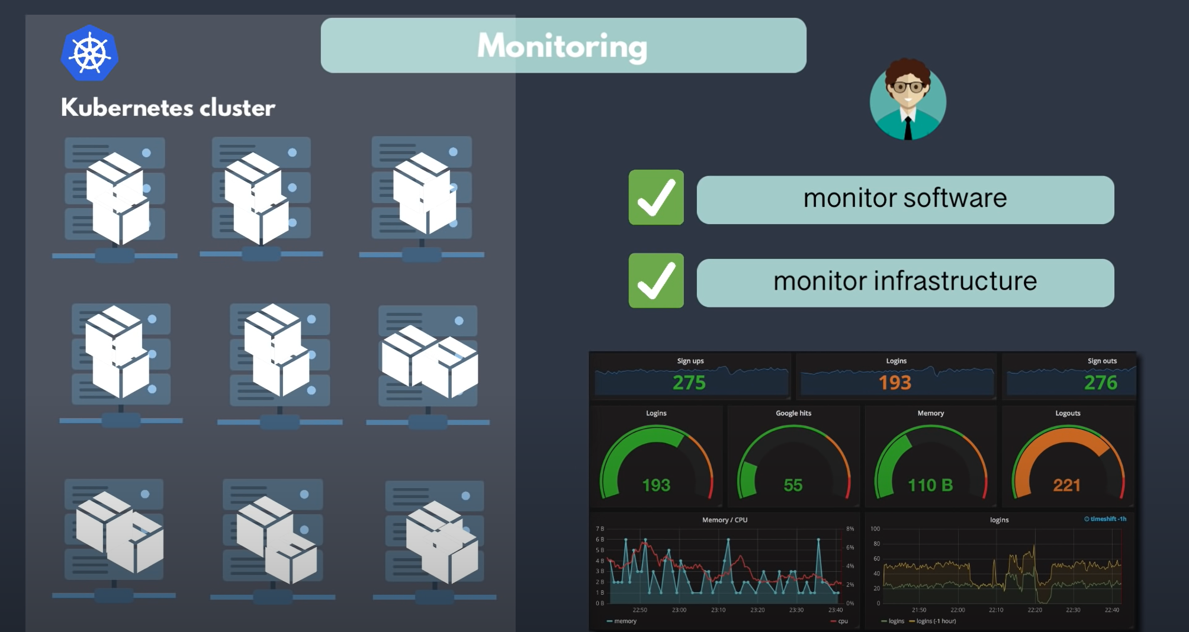
Linux: syslog, Logging level, rsyslog / rsyslogd, Demo: Remote Logging, E.L.K setup .
Kubernetes Monitoring: Prometheus or Nagios.

Slide 28
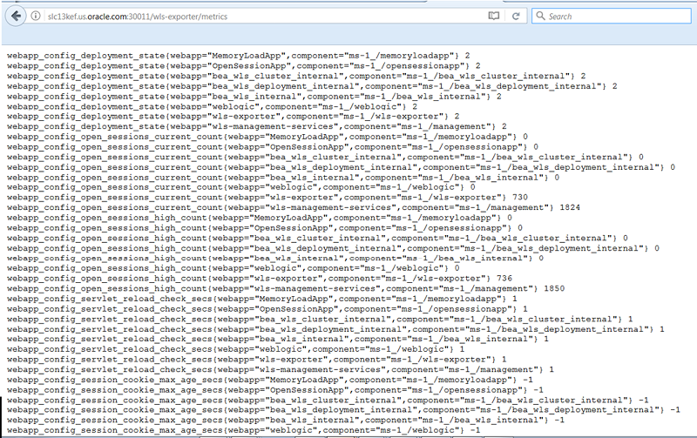
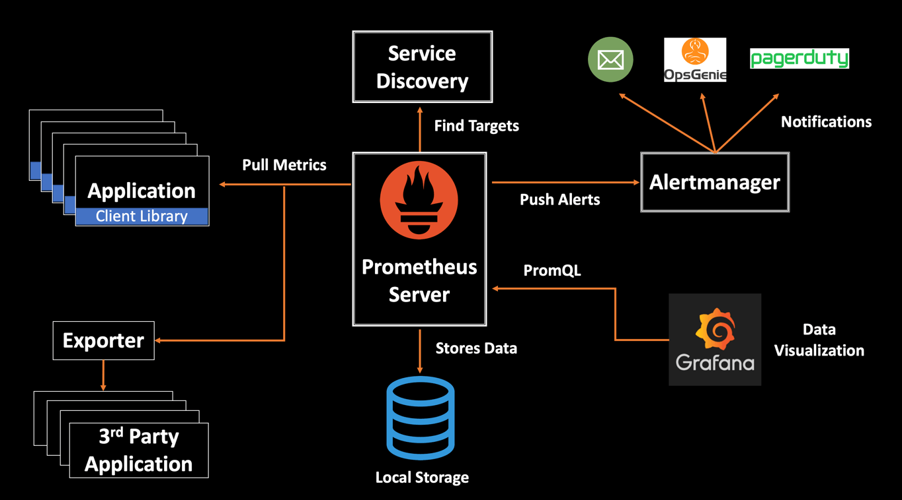
Kubernetes Monitoring - Prometheus

Slide 29
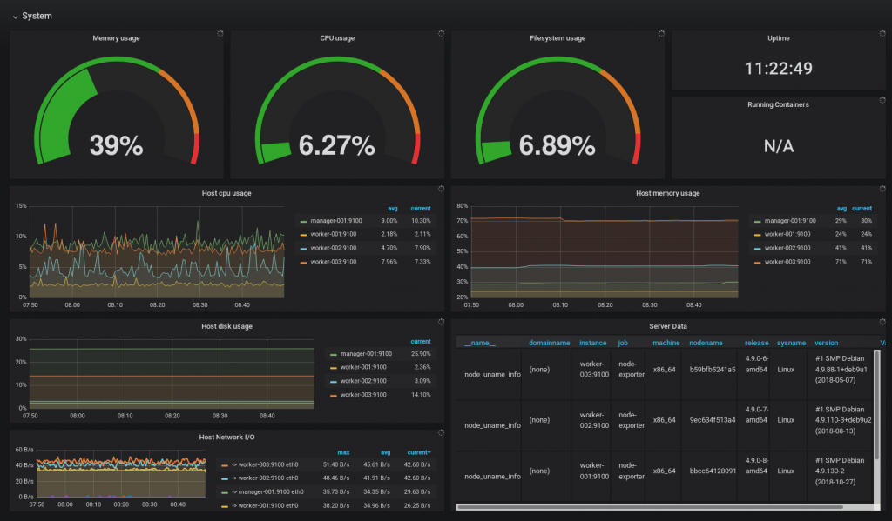
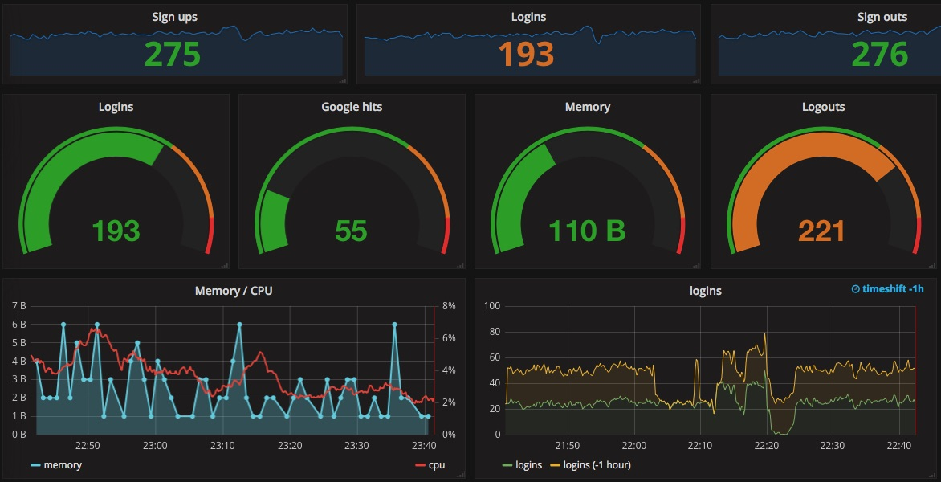
Kubernetes Monitoring - Grafana

Slide 30


Slide 31
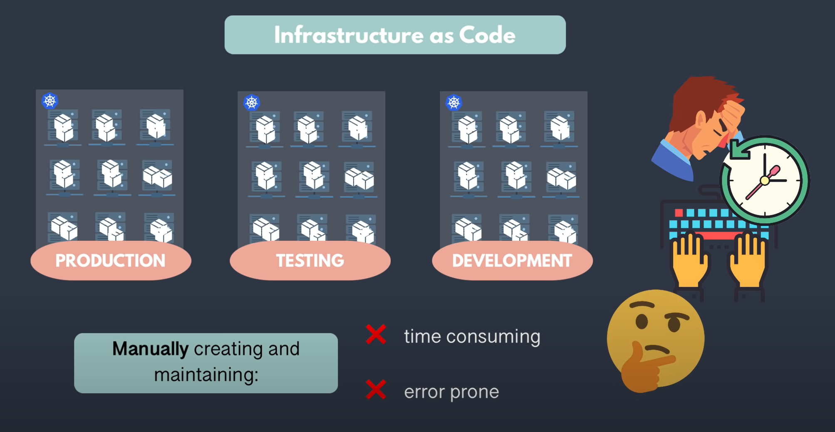

Slide 32
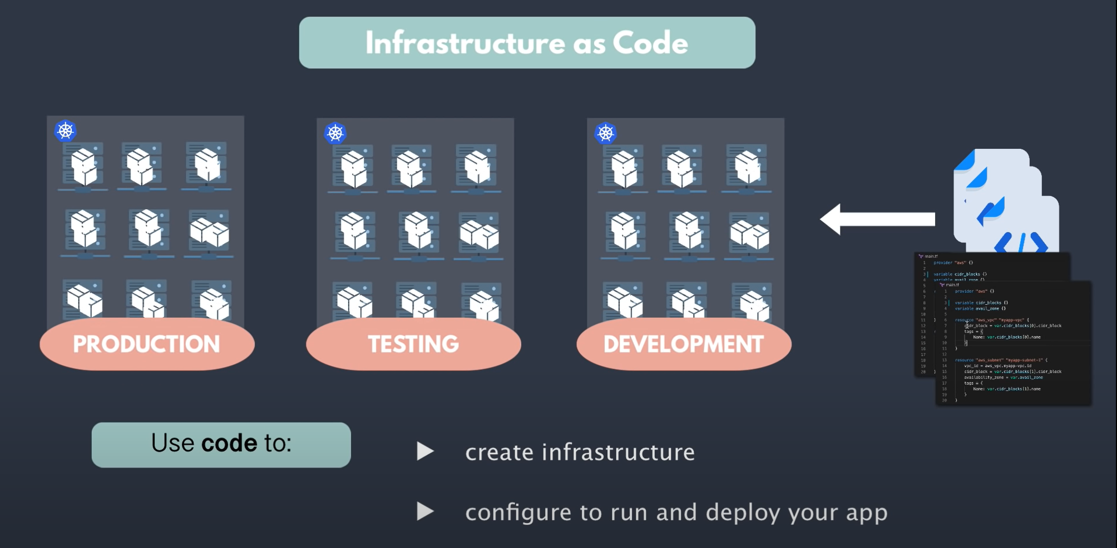

Slide 33
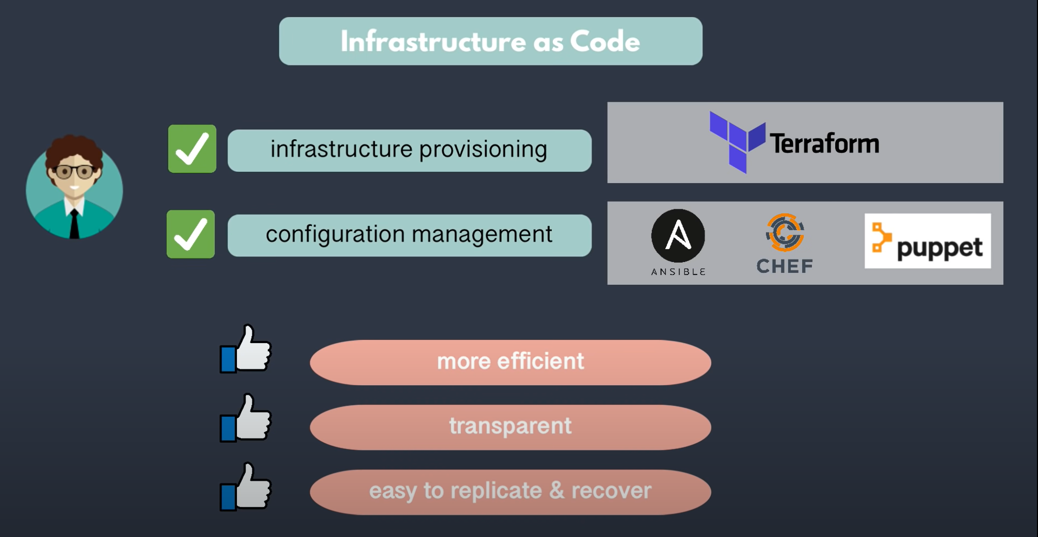

Slide 34
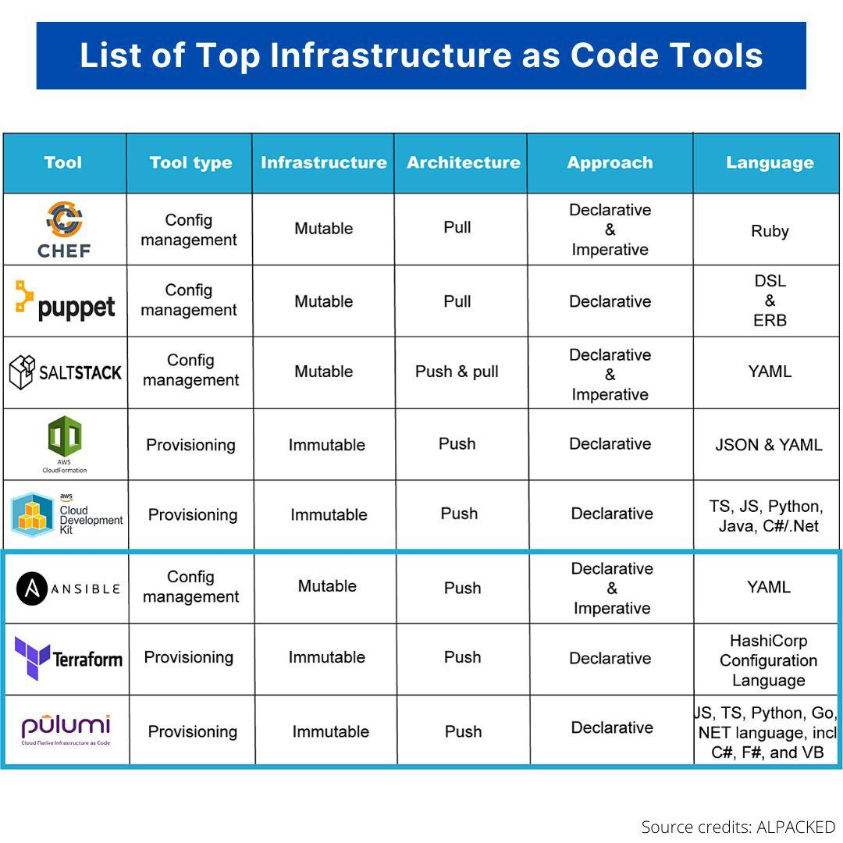

Slide 35


Slide 36
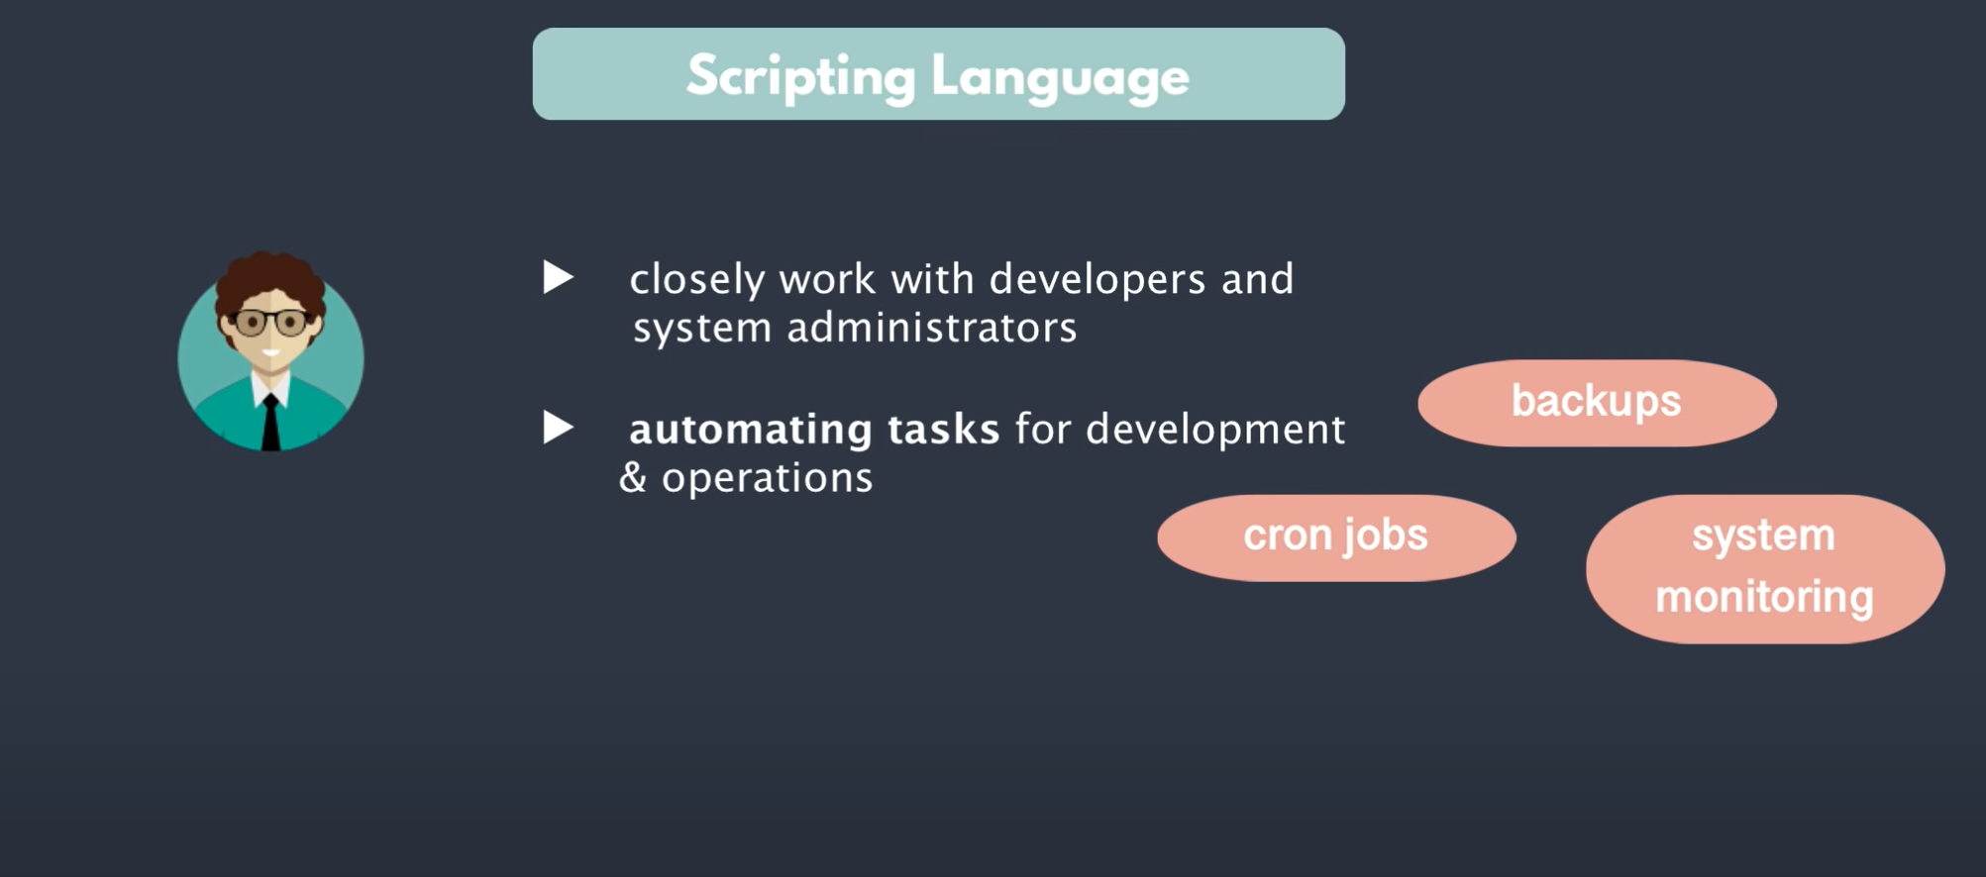

Slide 37
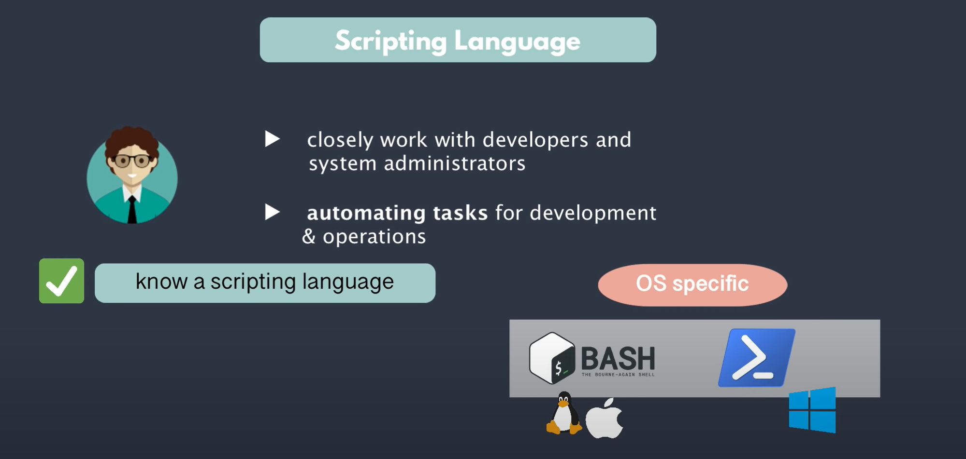
Bash Shell: Shell Variables, PATH, Aliases, fork(), file descriptors Bash Scripting: loops, conditions, etc..

Slide 38
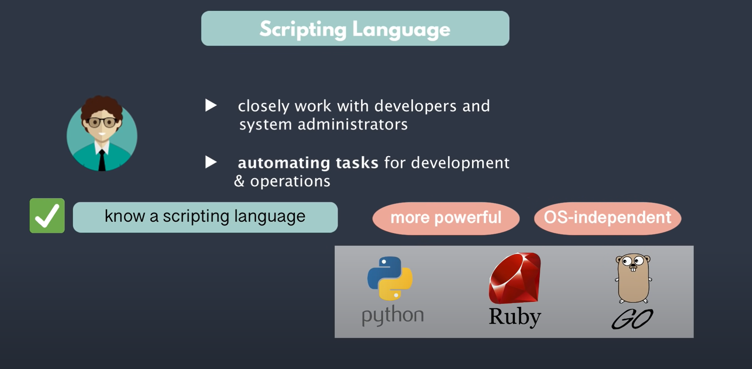
Coding: Proficiency in writing function and OOPS Concepts

Slide 39
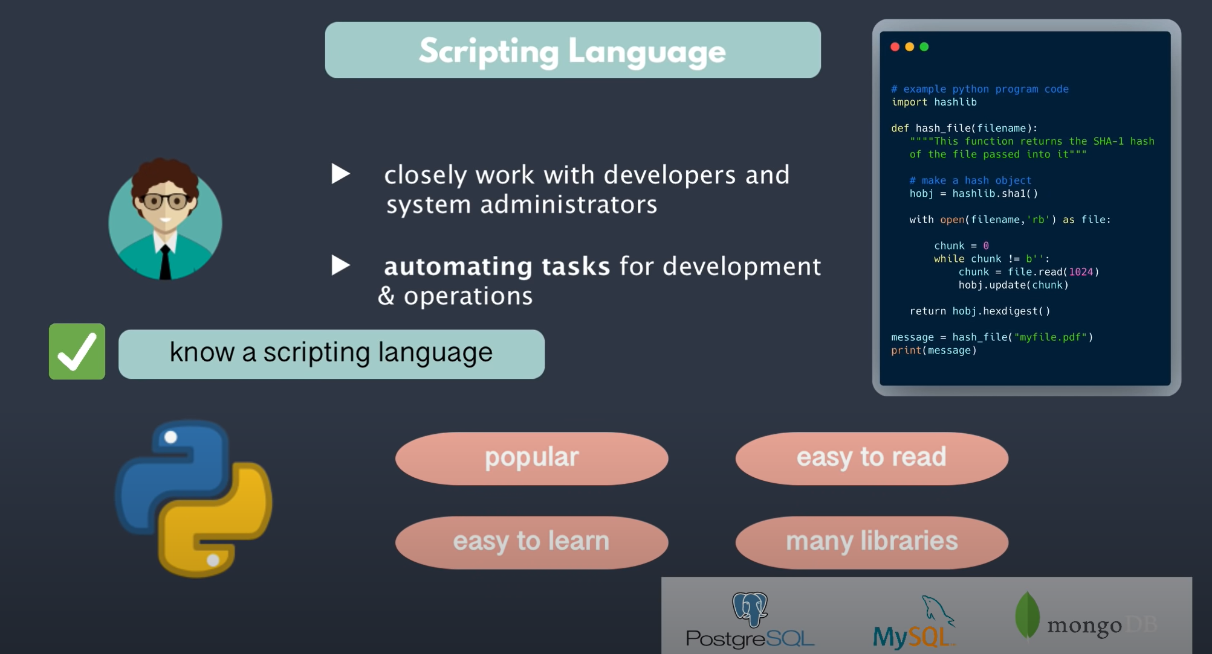

Slide 40


Slide 41
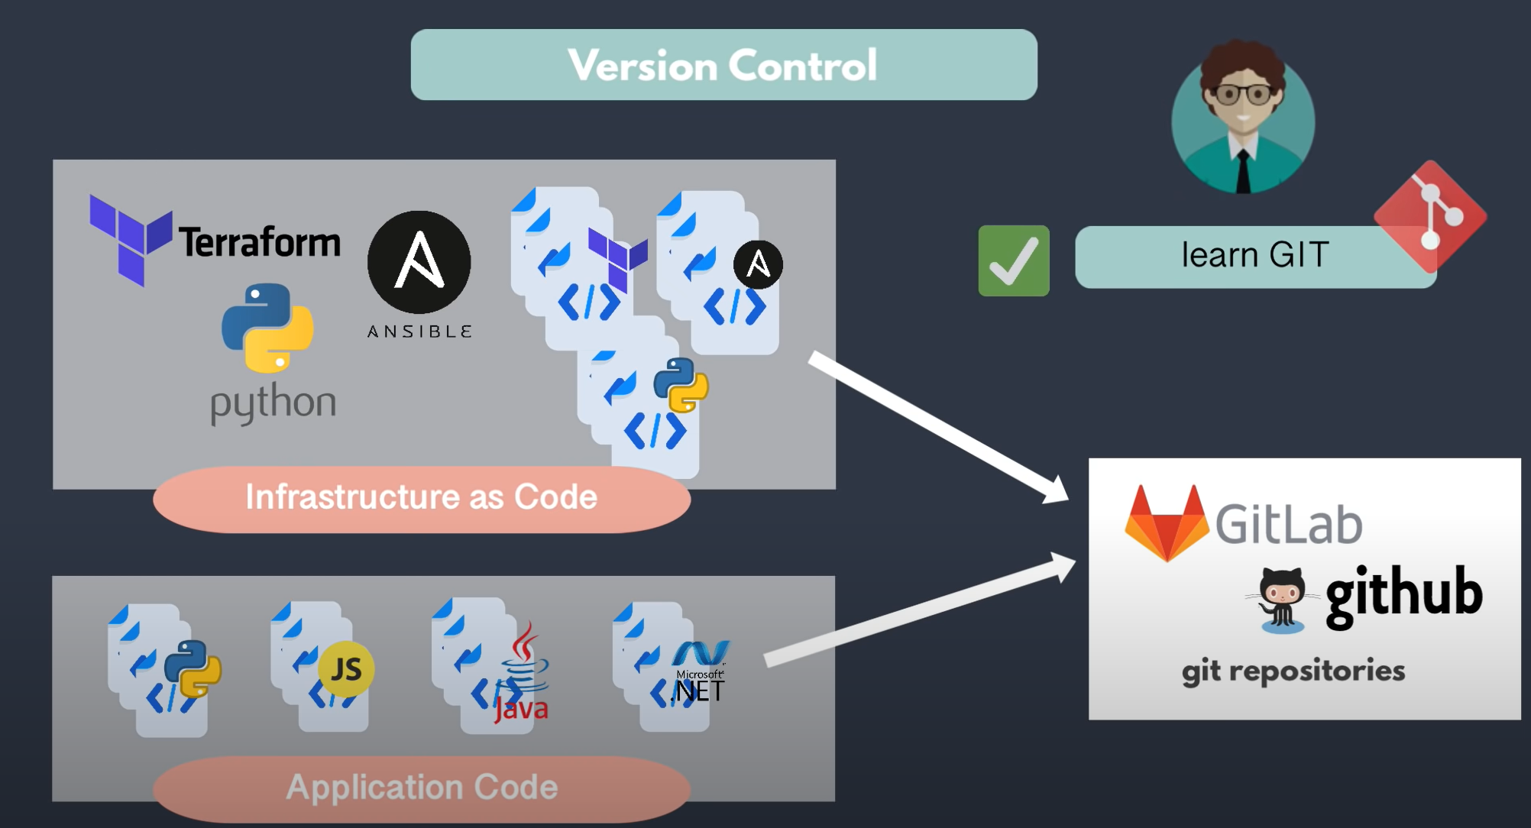

Slide 42
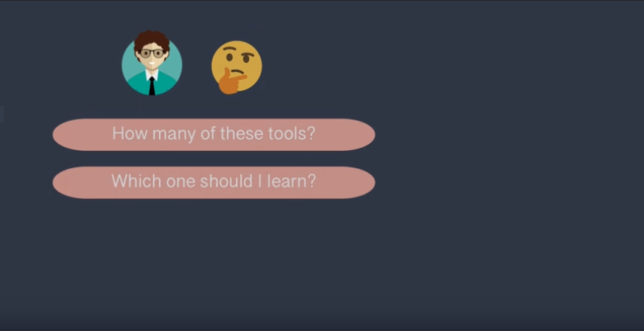

Slide 43
